Slide 1
Sensors

Slide 2
Sensors are for Perception
Sensors are physical devices that measure physical quantities.
– Such as light, temperature, pressure
Perceptual system of a robot
– Proprioception (internal)
– Exteroception (external)
• Sensor noise and errors are inherent in physical measurement, thus the challenge of uncertainty

Slide 3
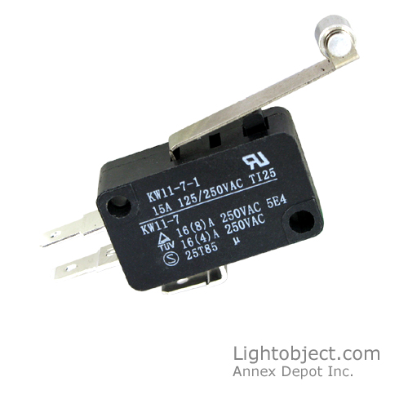
Switches
Switches measure current to detect an open or closed circuit.

Slide 4
Levels of Processing
• Electronics (low level): such as measuring voltages
• Signal processing (medium level): such as separating voice from noise
• Computation (high level): such as recognizing an object from an image

Slide 5
Examples
Bump Sensors (low)
Odometer (low)
Sonar (medium)
Speech (medium)
Vision (high)
Given the sensor input,
– Both simple and complex sensors can be used to answer the question:
What should a robot do? (action in the world)
– Complex sensors can also be used to answer the question: What was the world like? (reconstruction of the world)

Slide 6
Locating People
What kind of sensor would you use to locate people in a room?
Camera is the most obvious, but the most complex to process the signal.
Temperature: locate objects within human body temperature.
Movement: locate objects moving that are a certain size.
Color: locate objects of skin color, or human clothes.
Distance: locate objects that block a previously area that was open.
The sensors will need to be calibrated before use in the robot.

Slide 7
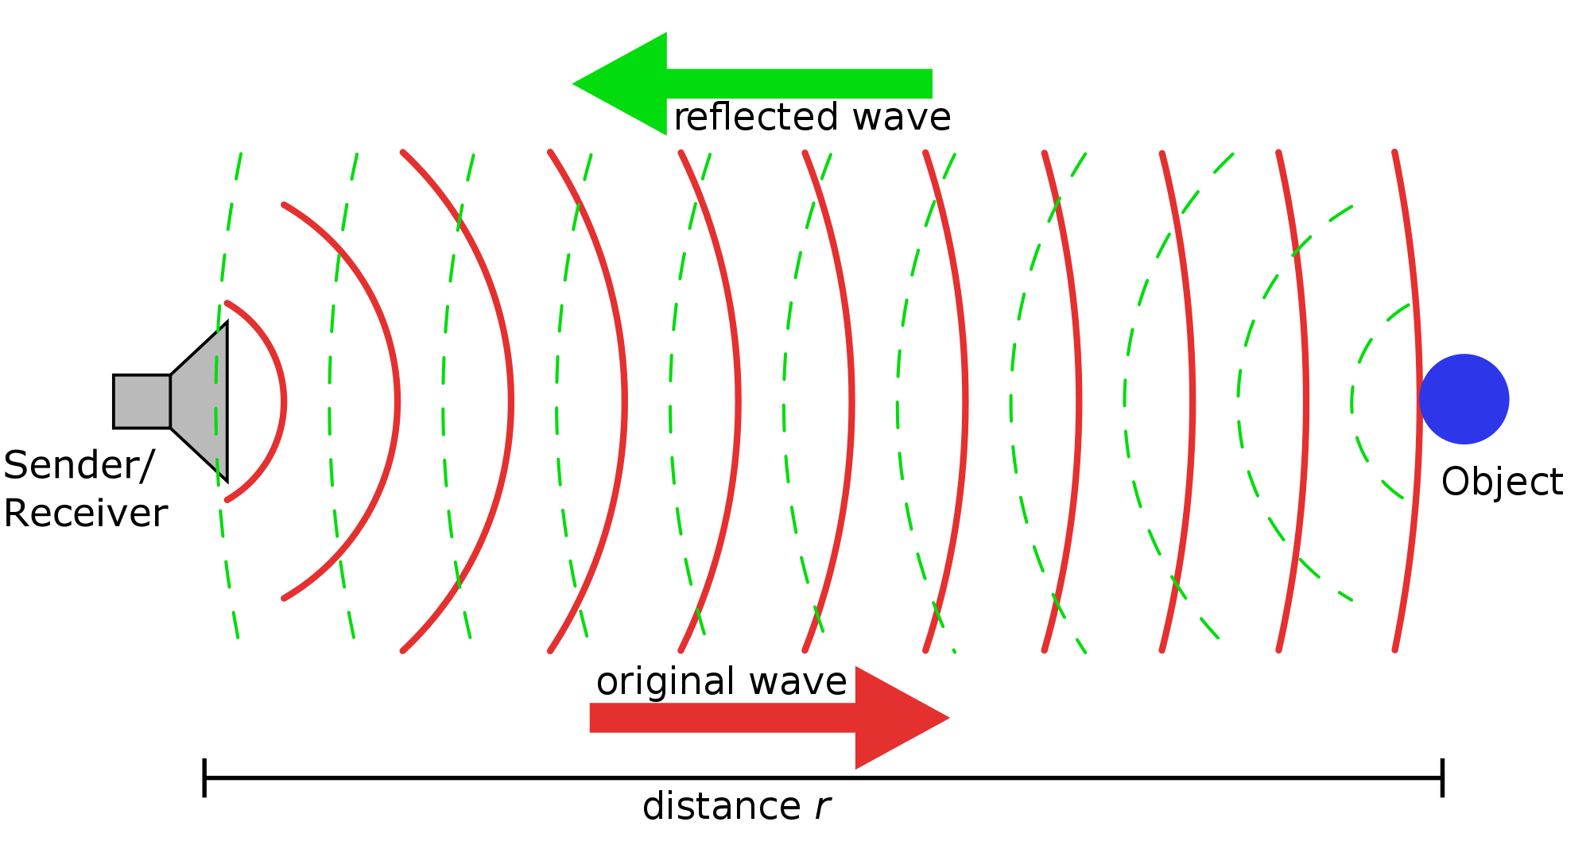
Finding Distance using Sonar

Slide 8
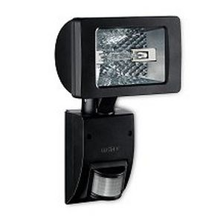
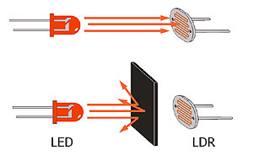
Simple Sensors
Simple Sensors are sensors that don’t require a lot of processing.
• Passive vs. Active (applies to both simple or
complex)
– Passive: measures a physical property only, with a detector
Ex: switches, resistive light sensors, cameras
– Active: provides own signal/stimulus, with both an emitter and a detector
Ex: reflectance and break beam, ultrasound and laser.

Slide 9
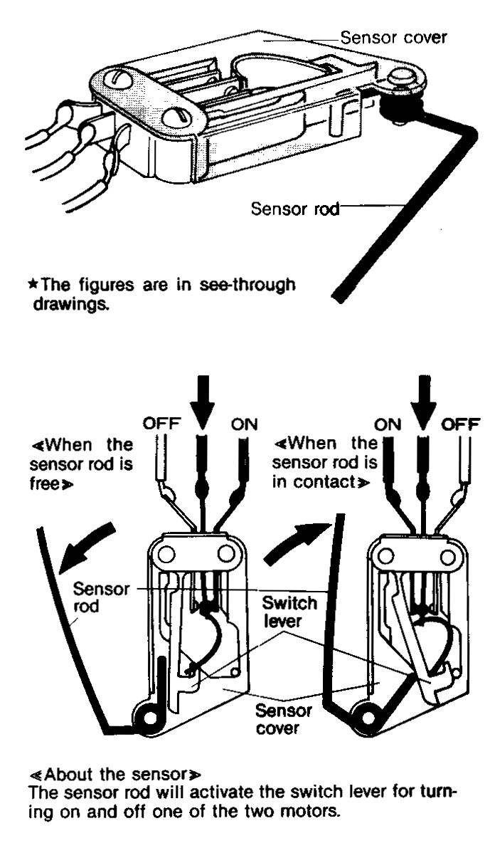
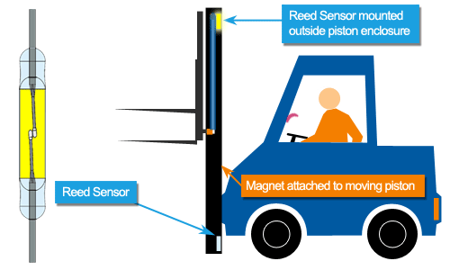
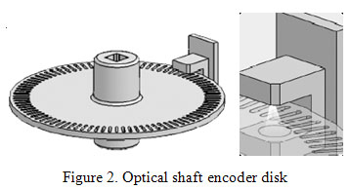
Types of Sensors
Limit sensor
Contact Sensor
Shaft encoder sensor

Slide 10
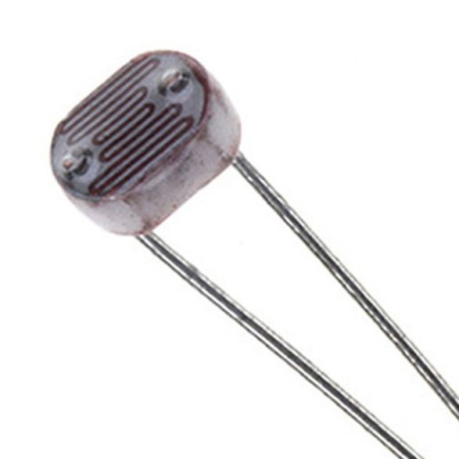
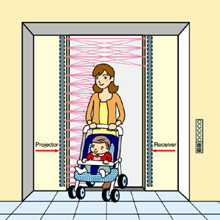
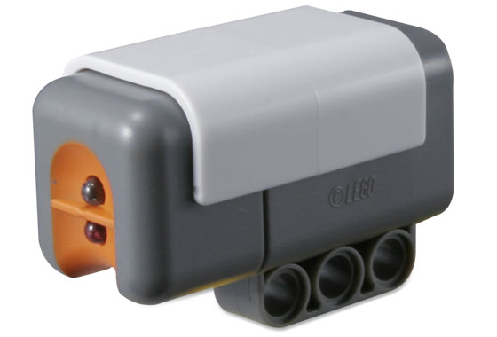
Light Sensors
• Photocells convert light intensity to resistance in the circuit
• Work even with invisible light (such as infrared)
• Could be used for measuring intensity, differential intensity or break in continuity
– Reflectance sensors: active sensors with emitter and
detector side by side
– Break beam sensors: emitter and detector face each
other
• Calibration is used to reduce noise

Slide 16
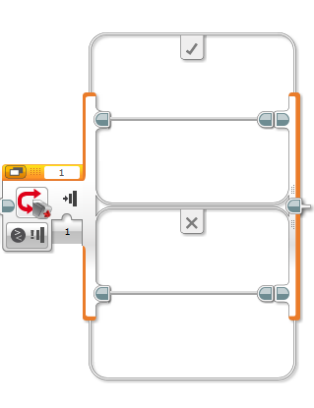
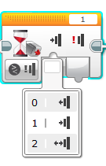
Decision Making
Sensory inputs, such as the value of the light sensor, will make the robot a little more intelligent.
• We need a decision-making mechanism so that our robots can react to their environment autonomously (without a human touching it).
• Decision making is achieved by conditional execution
in the programming environment.
• In MindStorms, by using Conditional Constructs (if-then-else) , we can allow programs to behave differently based on different values of sensor inputs.

